Slide 1
Student Congress with the Alumni 2014
By Mike Dalisay
codeofaninja.com
google.com/+MikeDalisay
@ninjazhai
fb.com/ninjazhai

Slide 2
What?
We were invited here to speak to you about “where are we now?” - since the time we graduated from this institution.

Slide 3
What?
We were invited here to speak to you about “where are we now?” - since the time we graduated from this institution.
We have to talk about the things we experience after college, not during our college.

Slide 4
Who am I?
My name is John Michael Vincent Dalisay

Slide 5
Who am I?
My name is John Michael Vincent Dalisay
You can call me “Mike”

Slide 6
Who am I?
My name is John Michael Vincent Dalisay
You can call me “Mike”
I’m 23 years old from Antipolo City.

Slide 7
Who am I?
My name is John Michael Vincent Dalisay
You can call me “Mike”
I’m 23 years old from Antipolo City.
A graduate of BSIT batch 2010, April.

Slide 8
Who am I?
My name is John Michael Vincent Dalisay
You can call me “Mike”
I’m 23 years old from Antipolo City.
A graduate of BSIT batch 2010, April.
I have a code blog called codeofaninja.com

Slide 9
Who am I?
My name is John Michael Vincent Dalisay
You can call me “Mike”
I’m 23 years old from Antipolo City.
A graduate of BSIT batch 2010, April.
I have a code blog called codeofaninja.com
We can be friends @ninjazhai & fb.com/ninjazhai

Slide 10
Current Position
I’m currently working as a Senior Software Developer for an IT solutions provider here in Quezon City.

Slide 11
Our Company
Eacomm Corporation

Slide 12
Our Company
Eacomm Corporation
I have been with the company for almost three and a half years now

Slide 13
Our Company
Eacomm Corporation
I have been with the company for almost three and a half years now
Exists since 2001

Slide 14
Our Company
Eacomm Corporation
I have been with the company for almost three and a half years now
Exists since 2001
Primary business is web based software development and interactive multimedia

Slide 15
Our Company
Now includes Android development since my R&D was a success.

Slide 16
Since I joined...
I personally worked with government agencies (DOLE)

Slide 17
Since I joined...
I personally worked with government agencies (DOLE)
Educational institutions (UP, Ateneo)

Slide 18
Since I joined...
I personally worked with government agencies (DOLE)
Educational institutions (UP, Ateneo)
Dozens of small and medium scale businesses (Canadian Hospitality Institute, Cafe Sweet, Calleza Grill)

Slide 19
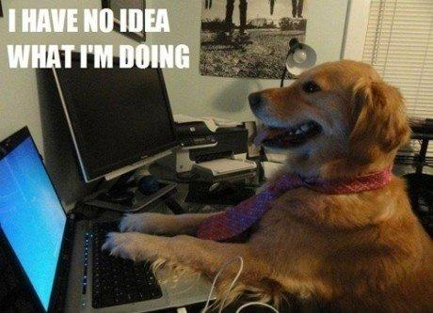
Junior Years

Slide 20
Junior Years
I worked mostly on client (such as the above) and company owned websites - philippinecompanies.com, eforuli.com, eacomm.com

Slide 21
Junior Years
I worked mostly on client (such as the above) and company owned websites - philippinecompanies.com, eforuli.com, eacomm.com.
I’m not a graphic or web designer. I mostly worked with the back-end stuff such as database and web programming.

Slide 22
Junior Years
I worked with a graphic designer for every website’s visual design.

Slide 23
Junior Years
I worked with a graphic designer for every website’s visual design.
I was a Junior Software Developer for over two years, from August 2010 up to December 2012.

Slide 24
One Step Forward
On December 2012, I signed some new papers.

Slide 25
One Step Forward
On December 2012, I signed some new papers.
I was promoted as a Software Developer. I’m not a Junior anymore.

Slide 26
One Step Forward
On December 2012, I signed some new papers.
I was promoted as a Software Developer. I’m not a Junior anymore.
Effective January 2013.

Slide 27
One Step Forward
On December 2012, I signed some new papers.
I was promoted as a Software Developer. I’m not a Junior anymore.
Effective January 2013.
This was the year when I almost stopped working with client and company websites

Slide 28
One Step Forward
On December 2012, I signed some new papers.
I was promoted as a Software Developer. I’m not a Junior anymore.
Effective January 2013.
This was the year when I almost stopped working with client and company websites
Sometimes they need some support

Slide 29
2013
Year 2013 was an awesome year for me.

Slide 30
2013
Year 2013 was an awesome year for me.
We signed with a big project.

Slide 31
2013
Year 2013 was an awesome year for me.
We signed with a big project.
I also personally worked with Google Singapore.

Slide 32
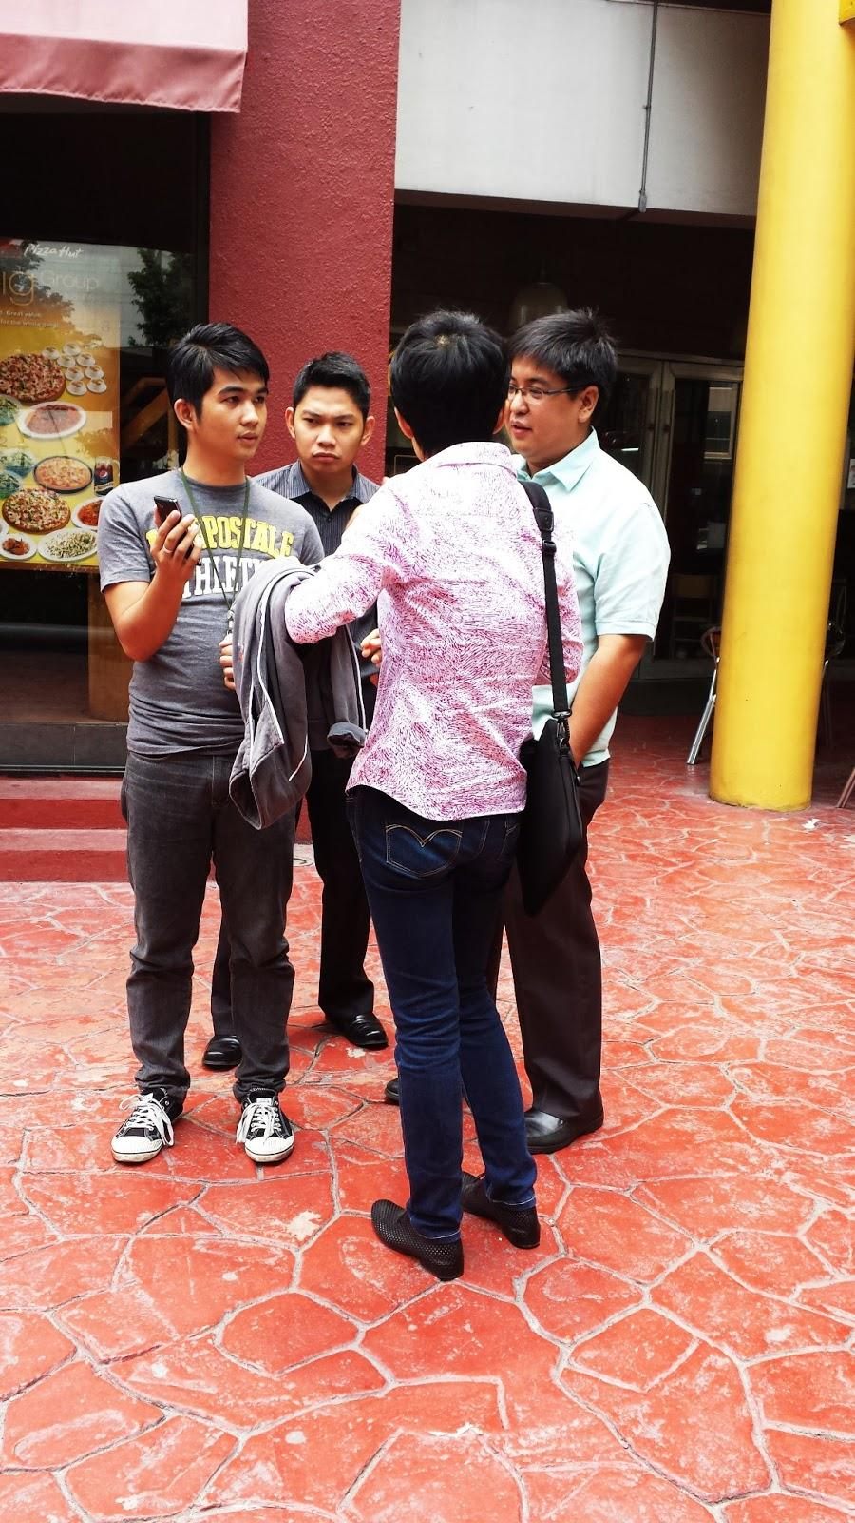
Me, Our business analyst, CEO and Ms. Zhang - a Google Product Manager and former Google Maps Software Engineer

Slide 33
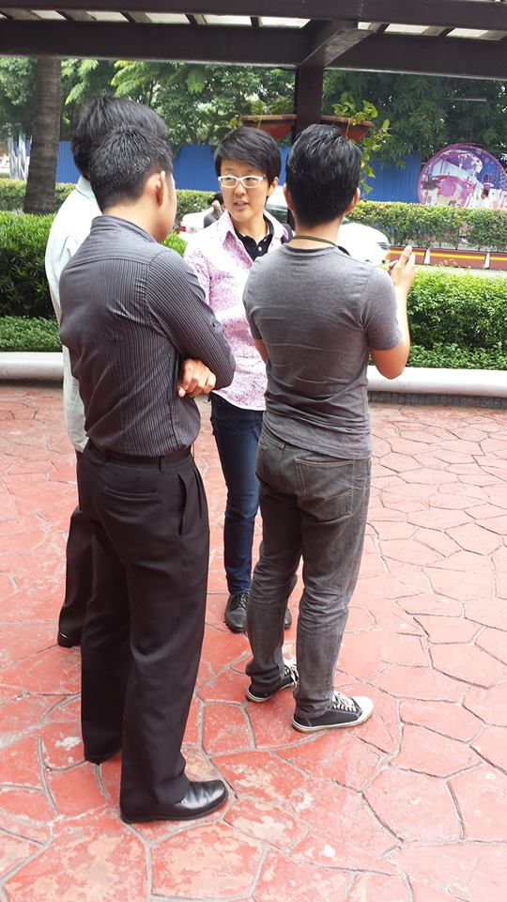
Me, Our business analyst, CEO and Ms. Zhang - a Google Product Manager and former Google Maps Software Engineer

Slide 34
2013
Also this year, our company joined an app development contest hosted by DOTC with some sponsors like Smart communications.

Slide 35
Our Entry
Click image to play video

Slide 36
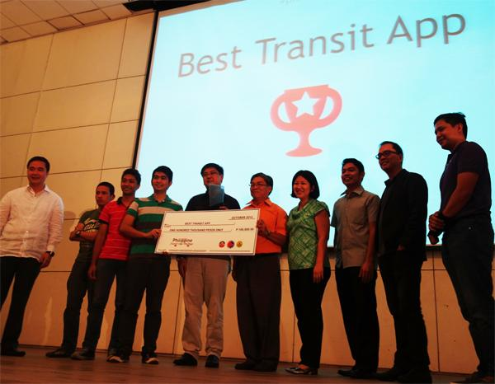
We won as Champions

Slide 37
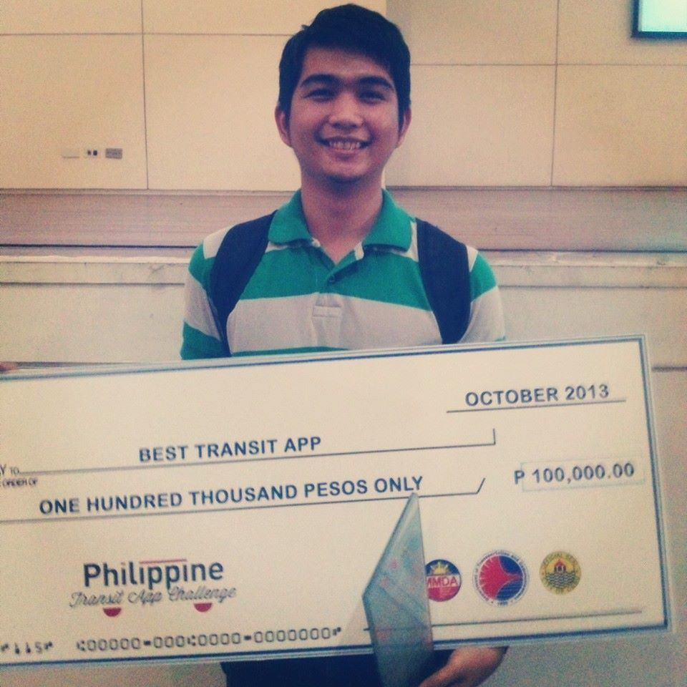
P100,000 and more prizes

Slide 38
Another Beautiful Step
Just recently (December 2013), I signed some new papers again.

Slide 39
Another Beautiful Step
Just recently (December 2013), I signed some new papers again.
I was promoted to a Senior Developer level effective this January 2014.

Slide 40
Another Beautiful Step

Slide 41
Future Career Plans
Like what most people say, I want to have my own company, my own business.

Slide 42
Future Career Plans
Like what most people say, I want to have my own company, my own business.
Maybe after some few more years, I’ll step into this stage of my life.

Slide 43
Future Career Plans
Like what most people say, I want to have my own company, my own business.
Maybe after some few more years, I’ll step into this stage of my life.
The reality is, I don’t want to be an employee my whole life.

Slide 44
Future Career Plans
I want to build something awesome, useful to people and make my own money from it.

Slide 45
Future Career Plans
I want to build something awesome, useful to people and make my own money from it.
I want to be an entrepreneur.

Slide 46
Future Career Plans
I want to build something awesome, useful to people and make my own money from it.
I want to be an entrepreneur.
My primary business will be in the IT field and after that, I will venture into food and real estate.

Slide 47
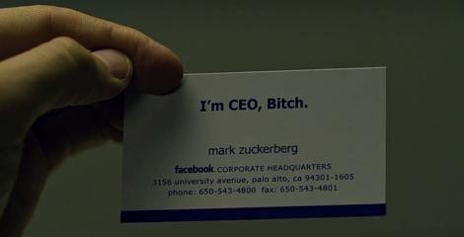
Future Career Plans

Slide 48
Some Good Quotes
Aside from my very inspirational and interesting story, I also want to present some awesome words from some well-known name in the tech industry.

Slide 49
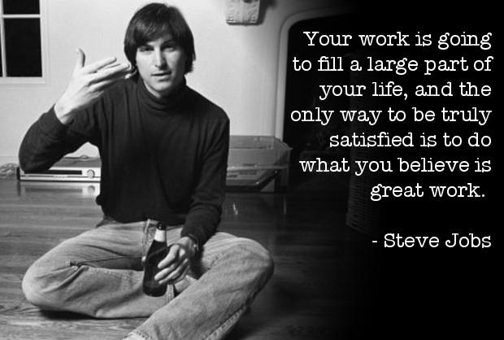
Apple

Slide 50
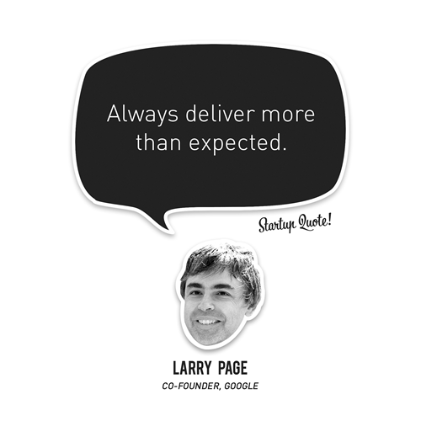
Google

Slide 51
Oracle

Slide 52
Facebook

Slide 53
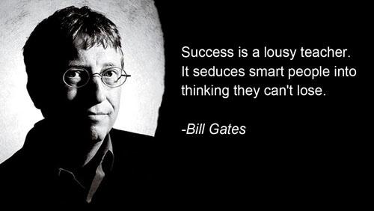
Microsoft

Slide 54
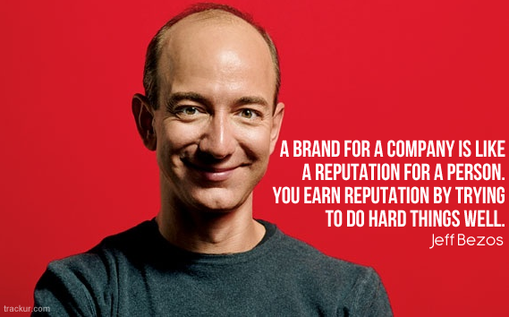
Amazon

Slide 55
Industry Testimonials
Click image to play video

Slide 56
Thank You!
Thanks for listening!
Visit www.codeofaninja.com for programming tutorials and tips
Let’s be friends:
google.com/+MikeDalisay
fb.com/ninjazhai
twitter.com/ninjazhai
Take care and God bless everyone!

